Slide 1

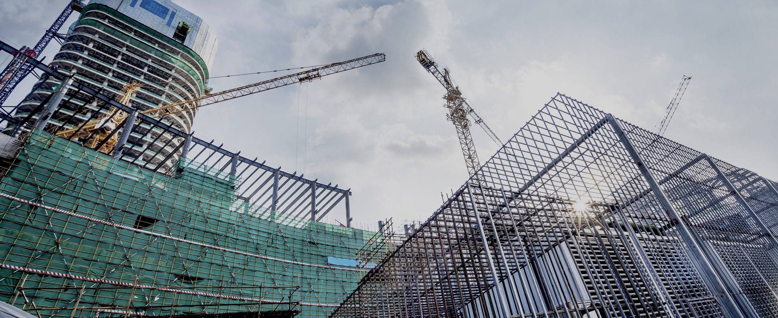
RAS Project Services
RAS Project Management
RAS Fabrication Services
RAS Equipment Brokerage
RAS References and Affiliate Contacts
Document Portal
RAS Services, LLC
al.smith@raspm.com asmith@rasservices.com 361-407-1868 www.rasprojectservices.com

Slide 2
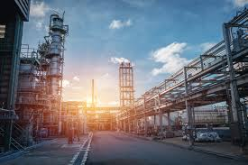
RAS Services, LLC
RAS Project Management
RAS Project Support Services
RAS Fabrication & Field Services

Slide 3
RAS Services, LLC
Established 2001
Serving Food-Beverage, Paper, Power, Fertilizer, Steel, Chemical, LNG, Petro-Chem, Oil & Gas industries.
Providing Project Management, Project Support, Construction Management, Construction Personnel, Engineering and Fabrication Services.
Proven success with Project Services including sourcing and brokerage of new and used equipment both domestic and abroad. Structural/Civil/Process/Environmental Engineering.
On-time, On budget track record for Engineering, Procurement, Fabrication and Installation services for Capital Projects and Turnarounds.
al.smith@raspm.com asmith@rasservices.com 361-407-1868 www.rasprojectservices.com

Slide 4
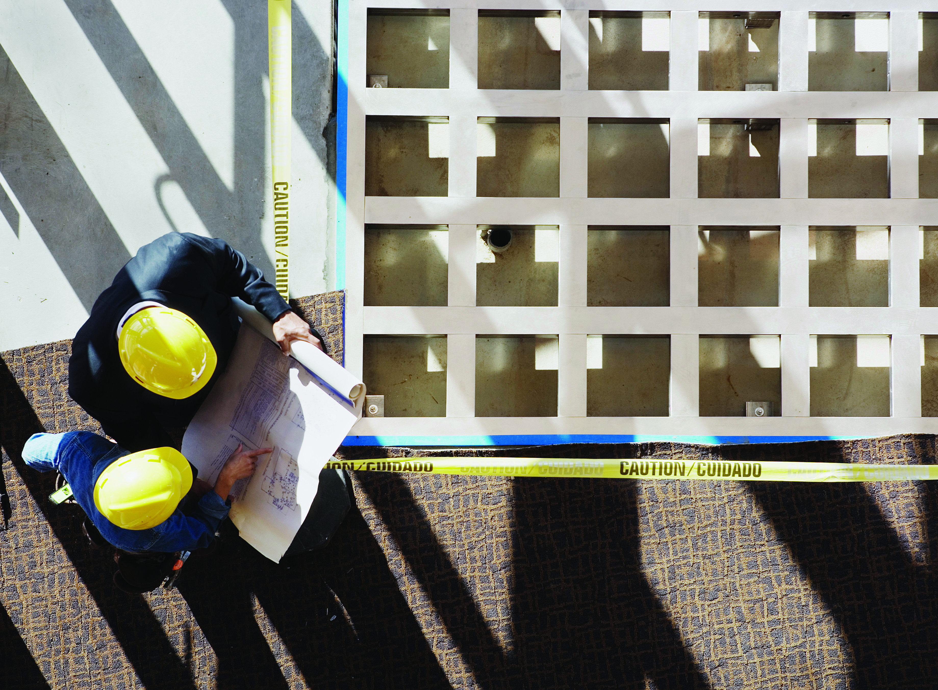

RAS Project Services - Brokered
Estimation / Scope / Budget / Work package Development – RAS Services has Certified Estimating Professionals available to provide project services during the developmental stages and detailed work packages for project execution. Our team utilizes the most current estimating software with multiple databases including industrial, commercial and specialty services in order to produce the most accurate industry specific estimates.
Scheduling – RAS Services has Planning & Scheduling Professionals on staff to provide detailed logic driven schedules that accurately forecast project execution, cash flows and resource requirements for a project. We work closely with the execution team in order to plan the most effective utilization of resources and produce accurate forecasts for remaining project cost and duration.
Constructability Reviews - RAS Services has a team of seasoned construction professionals with experience in performing detailed page by page reviews of construction drawings the determine constructability, means & methods, engineering completeness, engineering deficiencies and provide general input to make project execution more efficient.
Construction Management - RAS Services has experienced staff available to assist project owner in the execution of tasks from day to day plant operations to the execution of complex construction projects. We support activities including: Procurement, Expediating, Project Controls, Construction Execution, Quality Control, Construction Inspection and Commissioning Assistance.
Field Office Staff - RAS Services has experienced office personnel available to support both short and long term administrative needs. Our services include Personal Assistants, Clerks, Document Control and General Office Support.
al.smith@raspm.com asmith@rasservices.com 361-407-1868 www.rasprojectservices.com

Slide 5
RAS Services Capabilities Self
Perform / Brokered / Affiliates
Mechanical
Maintenance
Millwright/Mechanic
Welder/Pipefitter
Boilermaker
Equipment Operator/Rigging
Fire Sprinkler Systems
Vibration Monitoring
Construction/Small Cap
Piping
Structural Steel erection
Equipment Setting, Assembly, & Alignment
Electrical/Instrumentation
Project Controls
Electrical/Instrumentation
Civil
Specialty
Scaffold
Insulation
Pa int/Coatings
Asbestos Abatement
Lead Abatement
CUI
Fiberglass
Steam Tracing
Subcontract Management
Fiberglass
- Equipment
installation
- Rotating equipment
- Piping
- Towers
- Heat Exchanges
- Tanks
- Pumps
- Boilers
Plant Services
E & I
Turnarounds
Material Handling
  Facilities
  Warehouse
  Logistics Support
  Janitorial
  Grounds
  HVAC
  Tool Room
  Operations Support
  Electrical Installation
  Instrumentation
  Conduit
  Cable Tray
  Underground Power
  Overhead Lines
  Terminations
  Boilermaker
  Exchanger Services
  Scaffold/Insulation
  Paint
  Welder/Pipefitter
  Specialty Welder
  Planning/Scheduling
  Equipment Operator/Rigging
  Rail Loading
  Tank/Bulk Truck Loading
  Barge Loading
  Switching
  Packaging
  Drumming
al.smith@raspm.com 361-407-1868 www.rasprojectservices.com

Slide 6
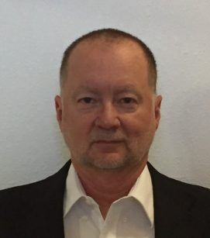
RAS Services, LLC
Leadership Bio
Al Smith was born and raised in Frostproof, Fla and attended Frostproof Jr-Sr High. He began his career in August of 1977 by joining the U.S.M.C. After Honorable Discharge, Al began his trek through the construction sector. He started out as a code welder for Watkins Engineers in the early 80’s and progressed into lower level supervision. He was hired into Cargill where he progressed from Maintenance Supervisor – Maintenance Manager – Project Manager – Sr. Project Manager.
Al has spent the last 19+ years overseeing emergency and high-risk outages and capital projects in Paper, Oil-Gas, Petro-Chem, Chemical, Mining, Fertilizer, Food Service, Biofuel and Power facilities.
Al has 30+ years of experience in the construction industry with Project Management oversight of FEED, FEL, estimation, schedule/planning, execution, cost control/tracking, reporting, commissioning and close-out procedures of capital projects. His reputation as a strong leader, whose strength at troubleshooting, identifying and eliminating potential problems, allows for completion of projects on schedule and within budget.
Al has a strong background in Capital Construction and Turn-Around Management including all forms of welding, millwright, ironwork, fabrication, heavy-rigging, crane and standard construction activities; development and implementation of reliability-based maintenance programs utilizing multiple forms of preventative, predictive and proactive formats; knowledge and disposition to manage multiple projects at one time across multiple sites; and emphasis on a safety culture based off focus on leadership and education towards a zero-incident safety foundation. Smith has accomplished Incident Free safety records multiple times with millions of safe work hours executed.
Al has developed an excellent core unit by affiliating with the best Engineers, Suppliers, Contractors and Contract Work force into long term partnerships ready to take on any challenge in the industry.
Al Smith
Owner/President
Phone: 361-407-1868 | www.rasservicesi.com |
al.smith@raspm.com asmith@rasservices.com 361-407-1868 www.rasprojectservices.com

Slide 7
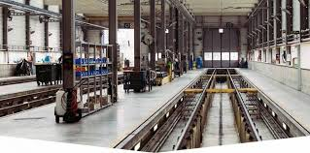
RAS Project Management
Successfully provided Project Management Services for Power, Fertilizer, Chemical & Food Beverage Industries since 2001.
Proven success in self performance and brokerage of Project Management Services in all disciplines to multiple industries.
Capability of Brokering Skilled Project Professionals to any client site location domestic or abroad.
Structural, Civil, Process, Environmental Engineering capabilities.
Associated with 100+ Engineering Firms, Fabrication Shops and Contract Groups ready for deployment.
Project Managers, Construction Managers, Project Coordinators, Planners, Schedulers, Q/C techs, Safety techs, Office Management, Material Management, Document Control currently available.
Effectively able staff and manage multiple projects on multiple sites.
Over 700+ skilled project craftsmen in current data base.
References available per industry application as requested.
al.smith@raspm.com 361-407-1868 www.rasprojectservices.com

Slide 8
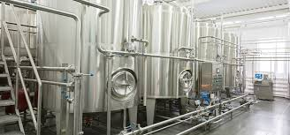
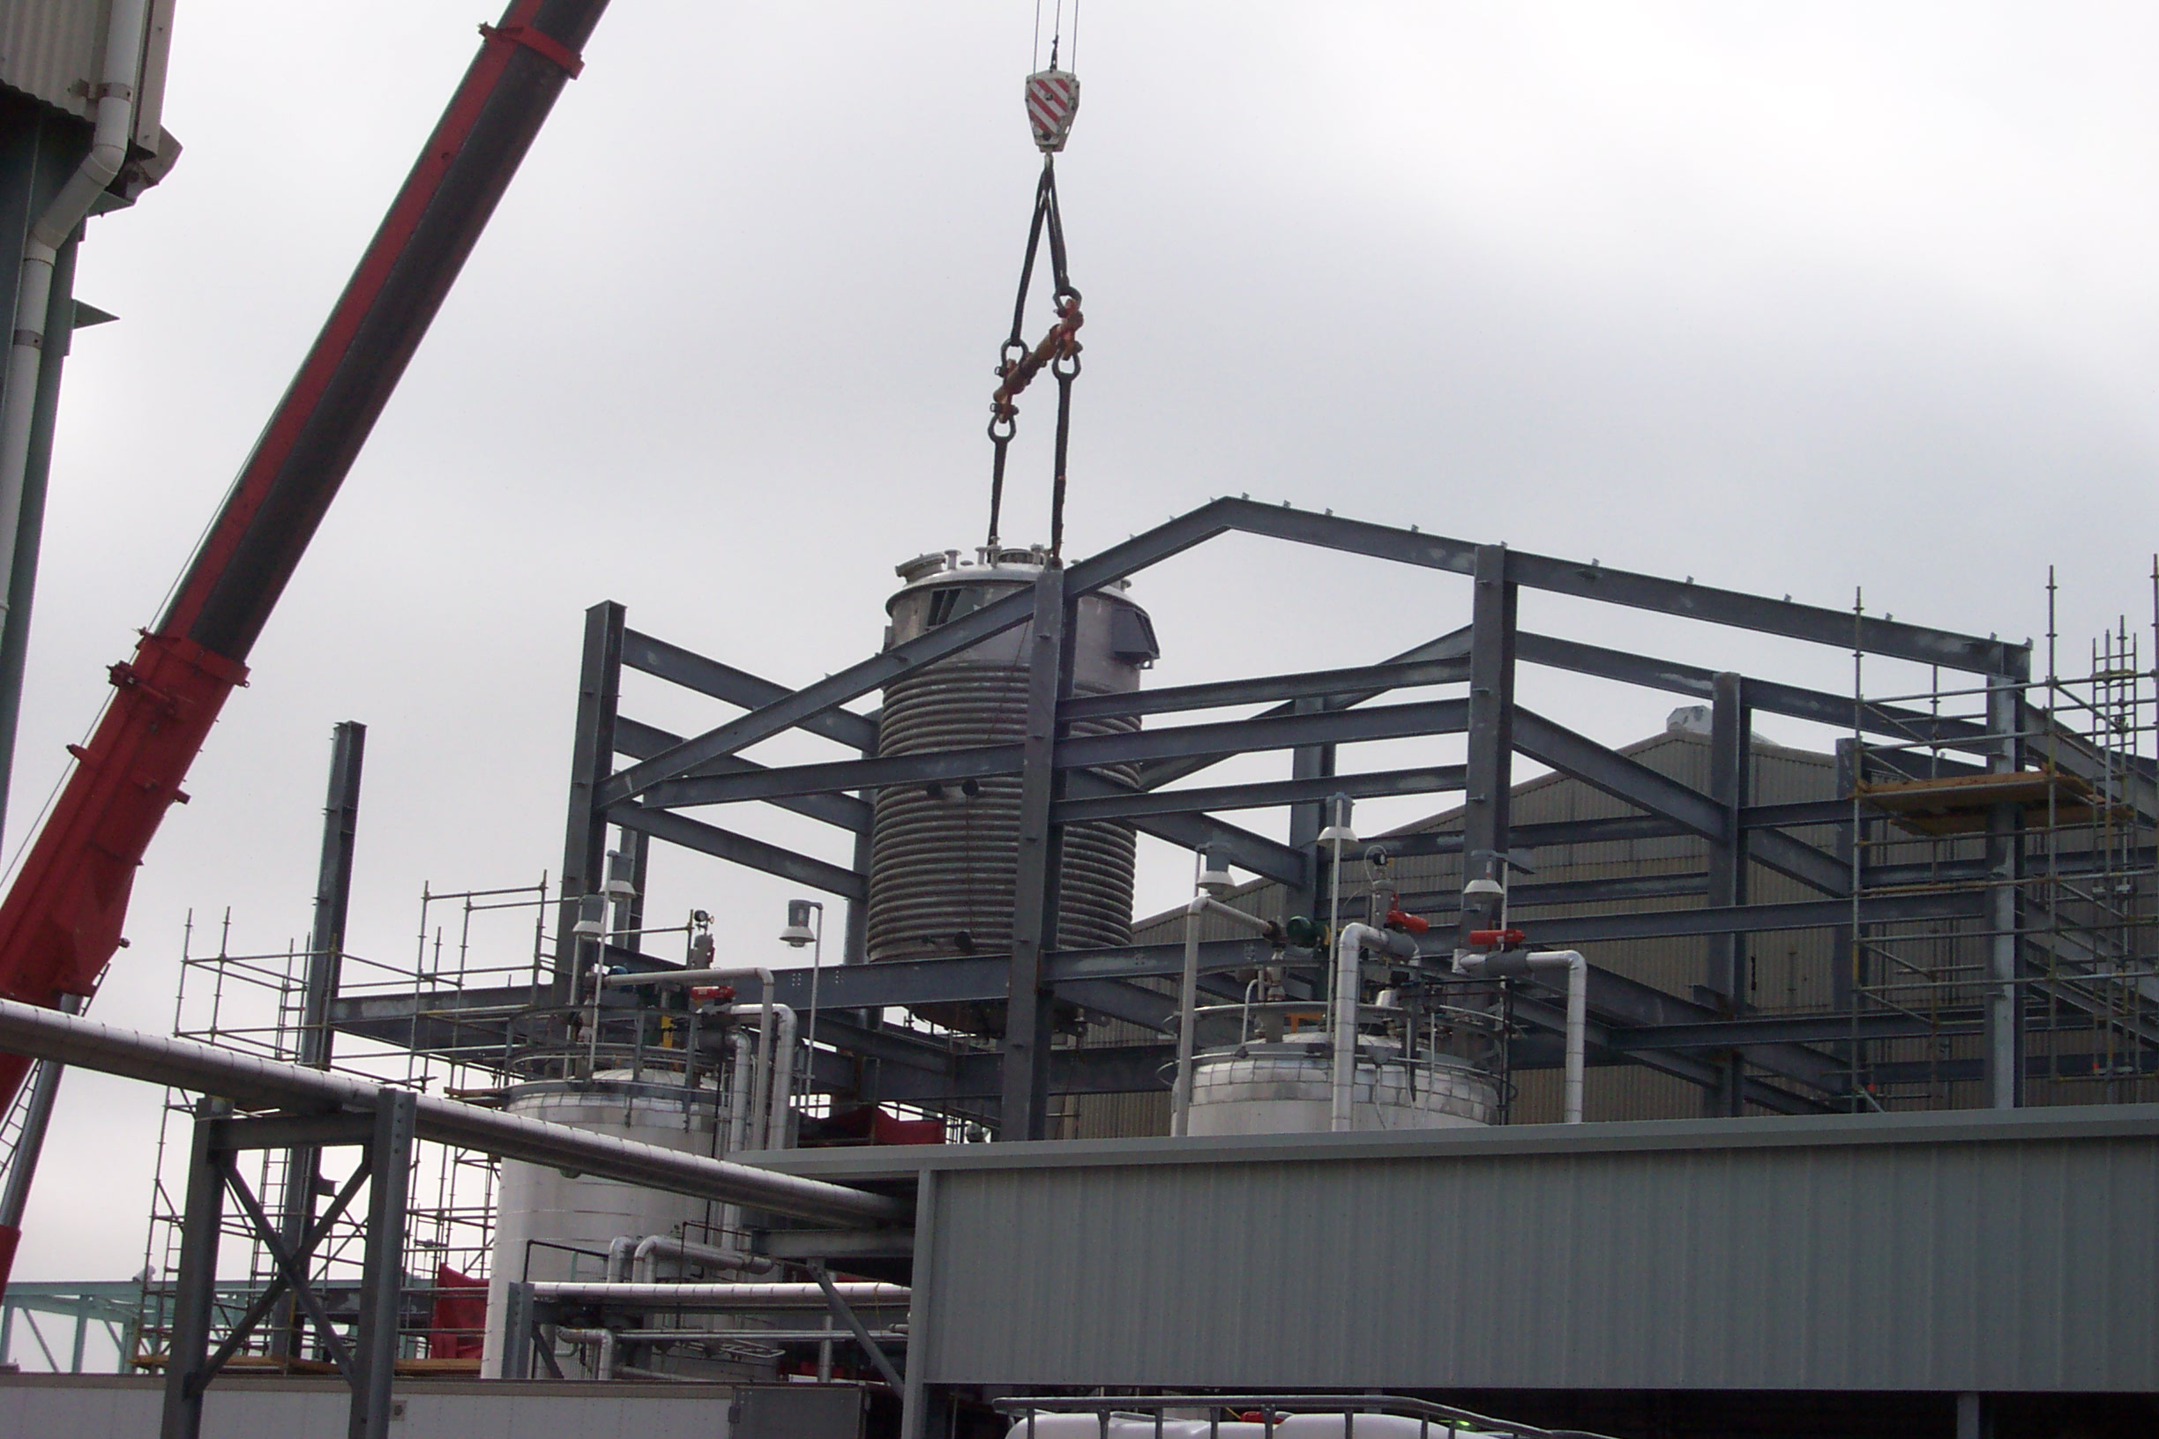
RAS Fabrication & Field Services
Associated with 100+ Engineering Firms, Fabrication Shops and Contract Groups ready for deployment. All prepared to provide services, equipment, materials, fabricated components as well as Project and Construction Management Professionals, or complete turnkey projects.
Aligned with multiple Engineering Firms, Fabrication Shops and Contractor Groups who have proven success records on T/M, Cost Plus, Fixed Fee and Lump Sum Capital projects completed on both domestic and foreign industrial sites ranging from $100k to $3B.
Fabrication and Installation of all forms of tanks, vessels and related equipment.
Fabrication
- Tanks
- Skids
- Vessels
- Platforms
- Stairs / Catwalks
- Conveyor Frame
Piping
Pipe Stands
Pipe racks
Piping
Duct work
Structural Steel
- Equipment Bases
-
al.smith@raspm.com asmith@rasservices.com 361-407-1868 www.rasprojectservices.com

Slide 9
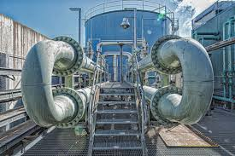
RAS Project Services –
Brokered Engineering, Fabrication & Equipment
Engineering Services.
Brokered Services / Equipment / Materials
Registered Export Trading Company (ETC) capable of sourcing new and used equipment to most markets both domestic and abroad.
Currently listing over 5000 used equipment items for available for purchase.
Unlimited access to new components to comply with all RFQ’s received. Dedicated team to source out items for validation and approval in an expedited, accurate manner to meet complex delivery schedules.
Access and experience with a majority of the US suppliers who constantly provide equipment with highest productivity and reliability factors along with greatest service life averages in the industry.
Equipment Brokered
-Pumps
-Fans
-Heat Exchangers (HX)
-Valves / automated/
-PLC's/ DCS
-Capability to provide complete mounted skids with control systems.
-Piping/ exotic metals: Titanium, zirconium, 316SS, 304SS, carbon steel, 308 and 309SS.
-Fiber glass resins: equipment built using Derakane, Atlas Vinyl Esters.
-Tank fabrication; certified and noncertified/ Stamped vessels.
-Boilers/ Generators/ Agitators.
-Instruments: Radar Level indicators, RTD's, Flow level control, etc....
asmith@rasservices.com 361-407-1868
www.rasprojectservices.com

Slide 10
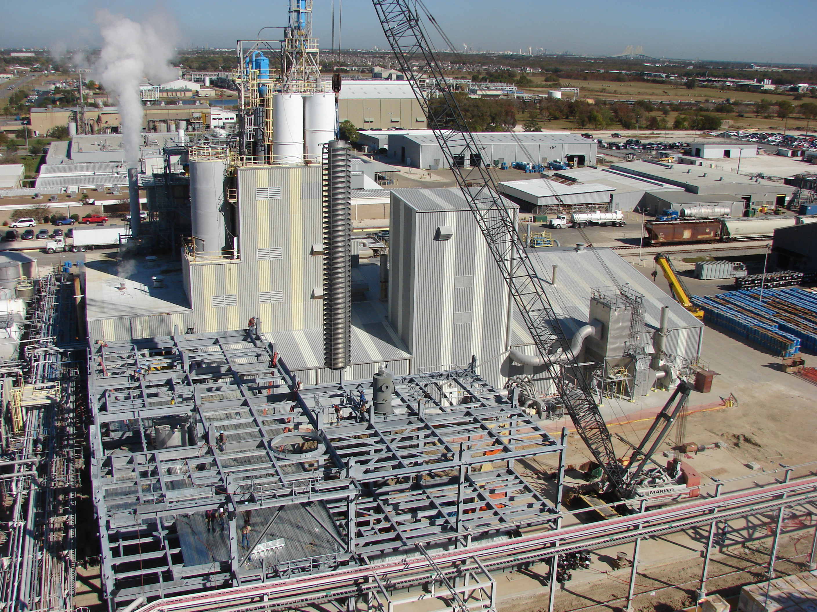
RAS Project Management
Mosaic Fertilizer
Micro Essential Expansion
St. James, Louisiana
Several of current team and affiliates worked with Hatch Engineering and Mosaic Fertilizer to design and build and retrofit the existing Faustina complex for a new fertilizer product called Micro-Essential.
Project was under extensive schedule demands to meet market needs. Working with Hatch and Mosiac teams along with awarded contractors all milestone schedules were adhered to and market shipments and contracts met.
This was a Full Field Development Project.
212 pieces of engineered major equipment and more than 6,000 instrument loops. This project included all manufacturing equipment, Conveyance systems, a new 200,000 sf warehouse and loadout systems to barge and ship access dock.
Project Bio
al.smith@raspm.com 361-407-1868 www.rasprojectservices.com

Slide 11
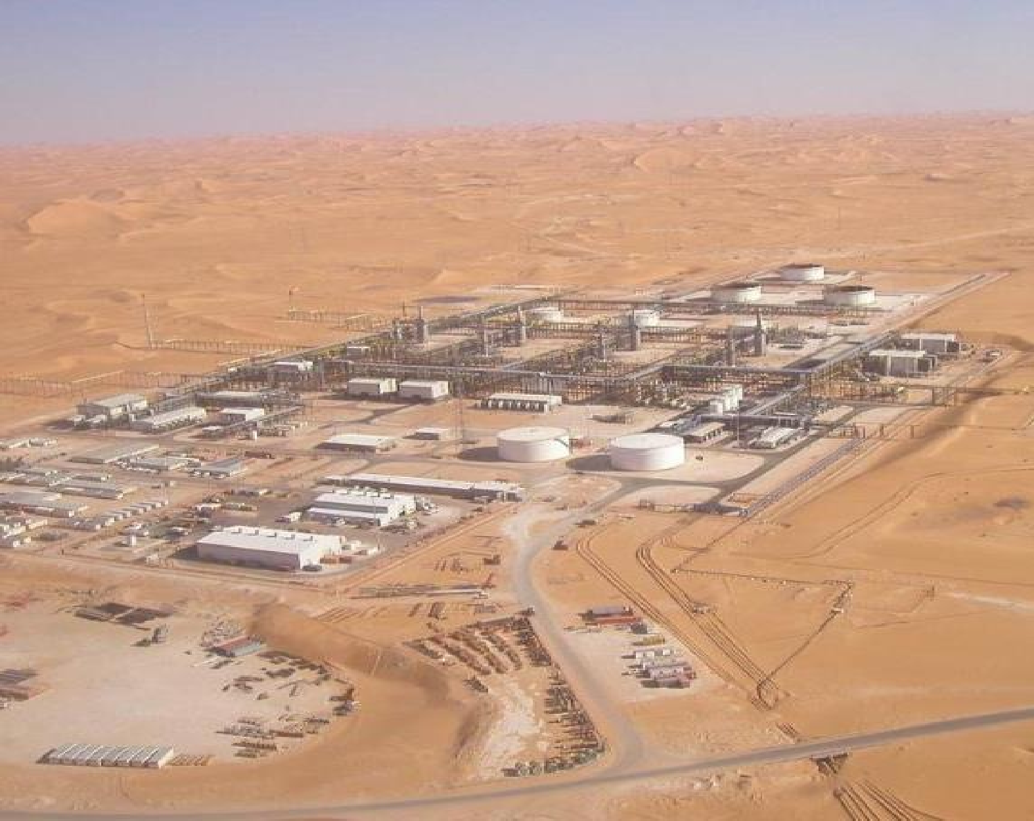
RAS Services, LLC
Affiliate
Project Bio
BROWN & ROOT CONDOR SPA. ANADARKO ALGERIA CORP. PHASE I & II HBNS PROJECT
HASSI BERKINE, ALGERIA
One of our current affiliates worked with Brown and Root when they formed a joint venture with the Algerian National oil company. Brown & Root SPA. was contracted for the Lump Sum Turn Key HBNS Full Field Development Project. ACP, LLC was selected as the instrumentation and commissioning subcontractor for the project. ACP, LLC’s scope of work was all instrumentation calibration, loop checks, DCS and safety systems commissioning for
(4) 84,000 BBL per day Crude Oil Separation and
Stabilization trains consisting of (440) pieces of engineered major equipment and more than 10,000 instrument loops. ACP,LLC was also responsible for the instrument installation and commissioning of (3) 90,000 BBL floating roof crude oil storage tanks, (84) wellheads, (1) 70,000 BBL per day water treatment and re-injection plant, (3) Nuevo Pignone Frame 7 turbine driven re-injection gas compressors, three electric motor driven Dresser–Rand process gas compressors and (2) frame five Thomasson Turbine Generators with all auxiliaries

Slide 12
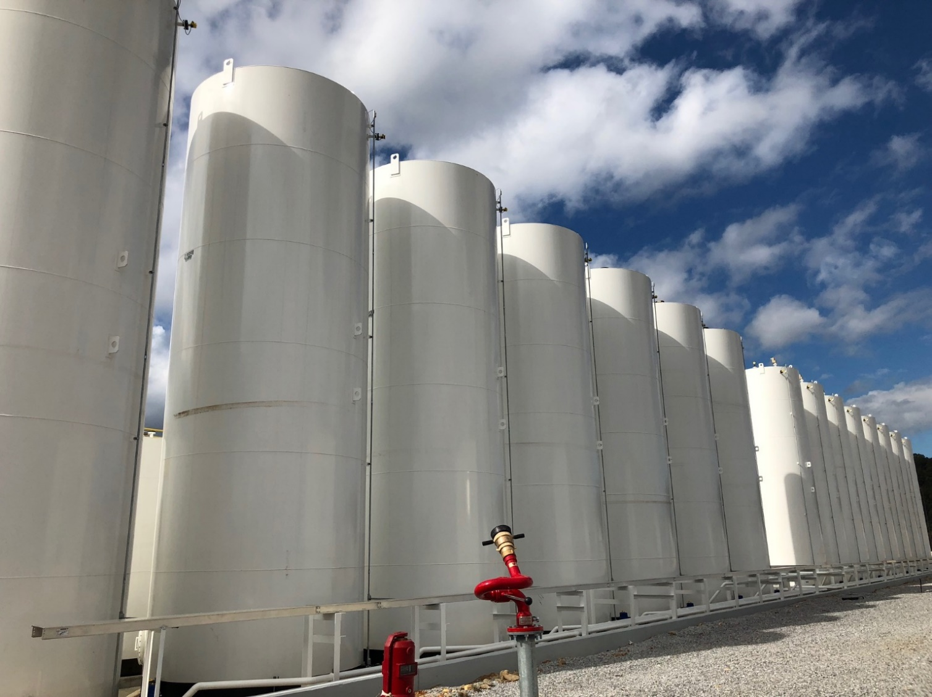
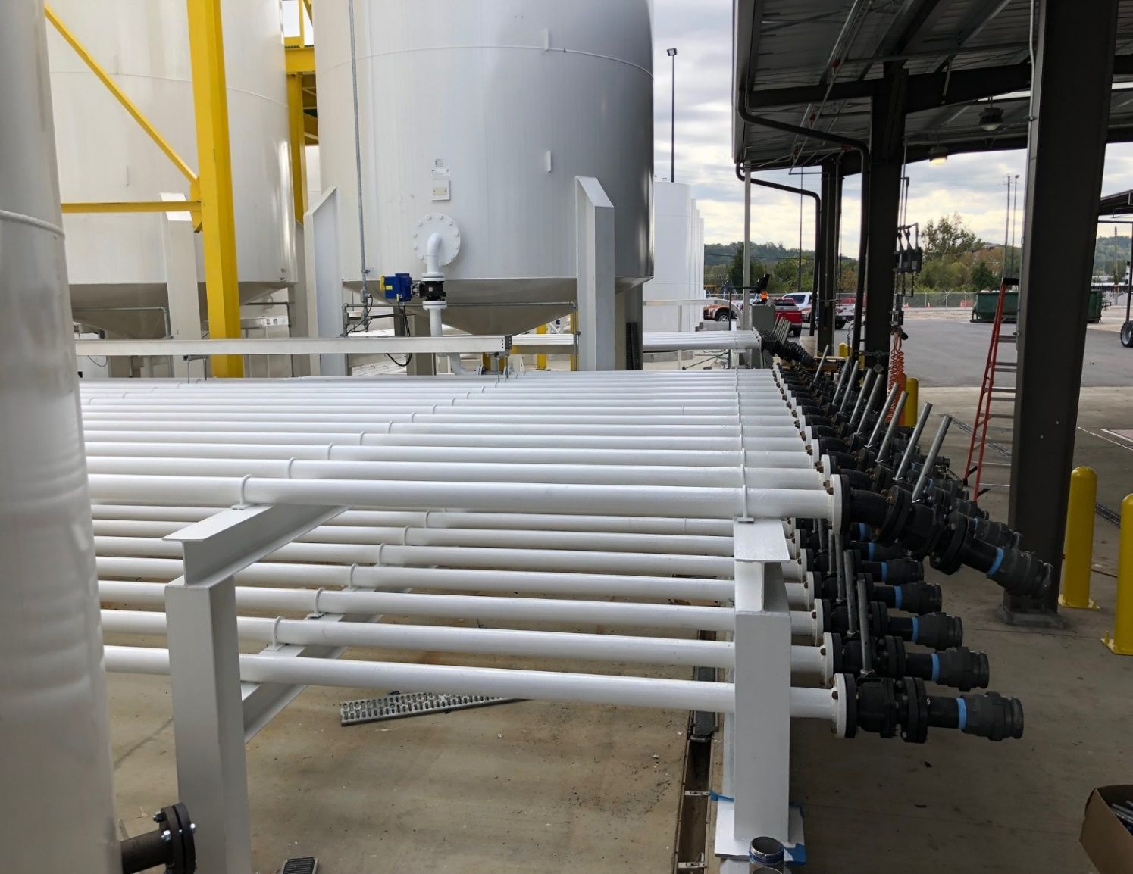
RAS Services, LLC
Affiliate
Project Bio
Customer: Research Solutions
Project: Tank Farm
Location: Pelham, AL

Slide 13
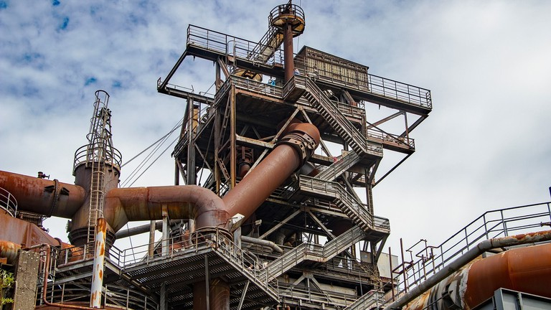
RAS Services, LLC and Affiliates Capabilities
  Construction & Capital Projects
  Steel Fabrication (Stainless, Aluminum & Misc.)
  Equipment Installation
  Motor & Fan Installation
  Process Piping
  Steel Tank Work (Fabrication & Installation)
  Emergency Response Work
  Confined Space Work
  Plate, Tube, and Angle (Bending)
  Mobile Crane Inspectors
  Welding
  Millwrights
  Install & Rebuild (Crushers, Chutes, Hoppers, Handrails & Platforms
Mechanical/ Structural/ Electrical/ Civil/
-Process Design and Integration
  Conveyor Fabrication & Installation
  Steel Erection and Rigging
  Laser Alignments
  Concrete Work
  Steel Ductwork (Fabrication & Installation)
  Safety Compliance & Code Work
  Plant Shut Downs
  Custom Plate Burning (CNC Plasma)
  Custom Steel Plate Shearing
  Industrial Maintenance
  Iron Workers
  Aggregate Mining Division
  New Construction and/or Demolition
  Chemical Division
  Pulp & Paper Division

Slide 14
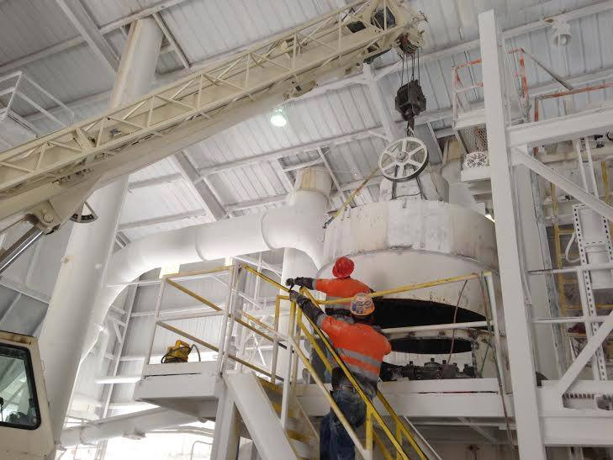
RAS Services, LLC and Affiliates Capabilities
Piping Services
RAS Services along with our affiliated partners, have the knowledge, understanding and capabilities to address your piping needs. From minor to major repairs, upgrades or new installation we have the ability to serve you.
Our goal at RAS Services is to develop every job into a long-lasting working relationship where we can become your one-call solution.
  RAS Services and Affiliates Piping Capabilities Include:
  Carbon and SS Piping and Pipe Fitting
  Fire/Sprinkler System Piping
  Steam Piping
  Air System Piping
  Process Piping
  Lined Piping
  Pipe Elbow Fabrication and Installation
  Coated Piping
  Process Control Systems
  Food Grade Stainless Steel
  Mondi Acid Piping
  HDPE Poly Piping
  .
al.smith@raspm.com 361-407-1868 www.rasprojectservices.com

Slide 15
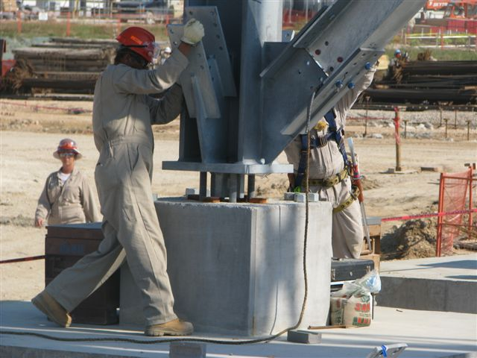
RAS Services, LLC and Affiliates Capabilities
De-Comm & Inerting Existing Lines
P/L Cleaning, Chemical & Mechanical
Progressive Pigging Services
Filling, Testing, Dewatering and Drying
Hydro-Testing of Pipeline, Piping and Pressure Vessels
Flange Torqueing and Tensioning Services
U.S.C.G. Dock line & Hose Testing
Pipeline P&A – Flushing
N2 Purging and Testing
Discharge Test Water Filtration
ILI Propel & Support Services
Rental of Hydrotesting equipment and Materials

Slide 16
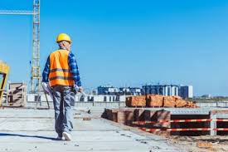
RAS Services, LLC and Affiliates Capabilities
  Liquid Transport
  Equipment Rentals Including Office Trailers, Storage Connex, Modular Units
  Roadway Installation
  Roadway Maintenance
  Holding Pond (lined/unlined)
  Holding Pond Maintenance
  Site Preparation
  Site Temp Facilities
  Site Civil
  Site Foundations
  Site Metal Building and Warehouse Erection
  Site Equipment Installation
  Site Piping Installation
  Site Electrical Installation
  Poly Pipe Installation
  Site Maintenance
  Site Support - Ice/Water, Trash Control, Janitorial, Material Transport, First Aid/Medical
  Security Fencing (Metal or Wire)
  Mobile Security Stations - Turnstiles, Badging Systems, Security Camera Systems
  Steel Piping Fabrication
  Steel Frame Component Fabrication
  Right Away Clearance /Maintenance
  Cattle Gap / Culvert Fab / Install
  Drainage and Watershed Pumping Systems
  Project Management Support Teams
  Soil Stabilization
  Environmental Engineering
  Retainment Ponds
  Foundations and area paving
-

Slide 17
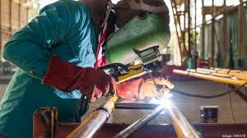
RAS SERVICES, LLC & Affiliates
Engineer, Design, Procure, Fabricate, Construct
RAS Services utilizes our experience in executing Capital Projects to perform Design Build Projects. With design build opportunities, RAS Services selects our project specific “best fit” engineering/design partner to join our project execution team. Some key advantages of EPC contracting are early involvement of the construction team that eliminates constructability issues, value engineering for materials of choice and the ability to fast track construction by performing construction tasks as engineering packages are complete.
RAS Services is open to the best contracting strategy for the successful execution of our clients’ projects. Some of the arrangements we have successfully worked in the past are:
  Engineer, Procure & Construct
  Engineer, Procure, Fabricate & Construct
  Engineer, Fabricate & Construct
  Cost Plus Fixed Fee
  Cost Plus Fee at Risk
  Time and Material Open Book
al.smith@raspm.com 361-407-1868 www.rasprojectservices.com

Slide 18
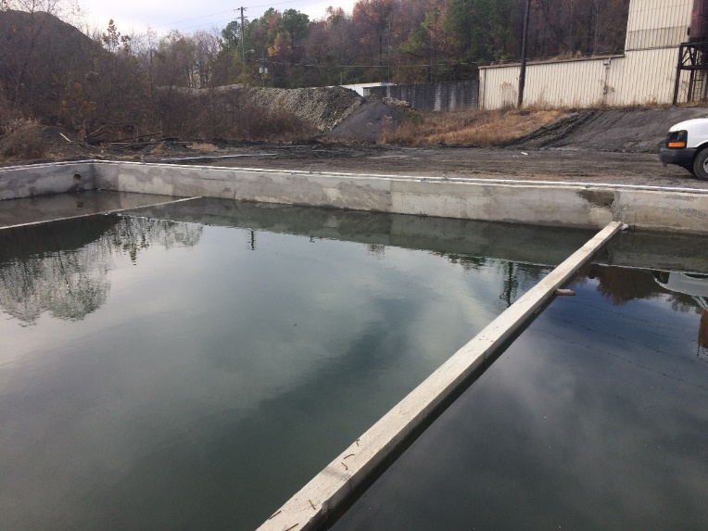
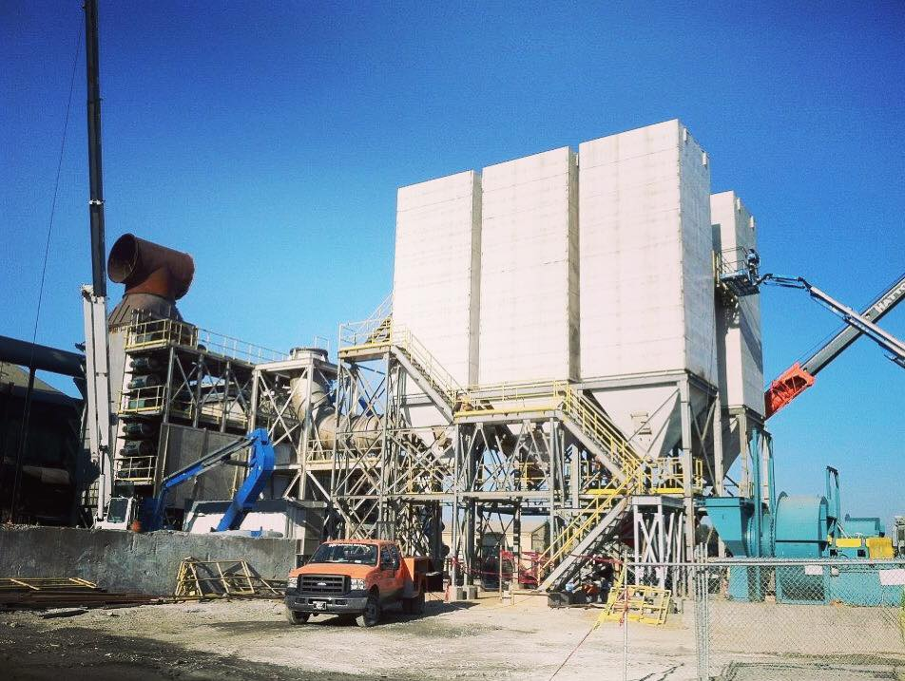
RAS Services, LLC and Affiliates Capabilities
Environmental Management
Pond Management - RAS Services offers turnkey solutions to pond management and materials handling tasks. We have experience in dredging or conventional pond cleaning with onsite dewatering capabilities. Our processes are tailored to the individual needs of specific materials and owner requirements.
Material Handling - RAS Services has a team of material handling experts available to help manage the day to day plant operational requirements for transportation, storage and either onsite or off-site disposal of materials. Our team has vast experience in the handling of chips, coal, ash, slag, lime, and other materials that require around the clock monitoring and management.
Liquids Management – RAS Services has partnered with multiple partners who offer expertise in liquid handling. Our team has the equipment and expertise available to provide filtration, separation and treatment of most process liquids. These services include oil filtration, oil/water separation, solids removal and disposal.
al.smith@raspm.com 361-407-1868 www.rasprojectservices.com

Slide 19
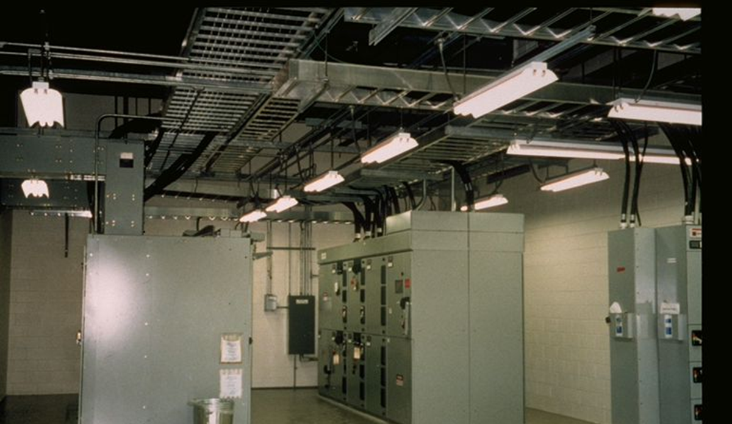
Additional Services Provided by RAS Affiliates
Industrial Electrical and Instrumentation Construction, Commissioning and Maintenance
Powerline Construction and Maintenance
Electrical Substation Construction
Electrical Testing and Oil & Gas Facility Commissioning
Power Generation Plant Construction, Commissioning and Maintenance
Electrical and Instrument Skid Assembly – Fuel Gas Measurement Skids
Temporary Power Skid assembly and sales.
PLC & DCS Modifications & Upgrades
Engineering, Procurement and Construction -Turn Key Projects
Emergency Temporary Power Generation - Natural Disasters – Storms
Disaster Relief – Ice/Water/Temporary Housing/Man Camps

Slide 20

RAS Services, LLC
  RAS Services, LLC has generated 100’s of contacts and references over many years. These contacts are kept confidential. Many are willing to provide reference for RAS capabilities upon request for a specific RFQ, Project or industry.
  These contact and references can be available upon request.
al.smith@raspm.com 361-407-1868 www.rasprojectservices.com

